Slide 1
Batch Normalization
李晓宇
2020.10.12

Slide 2
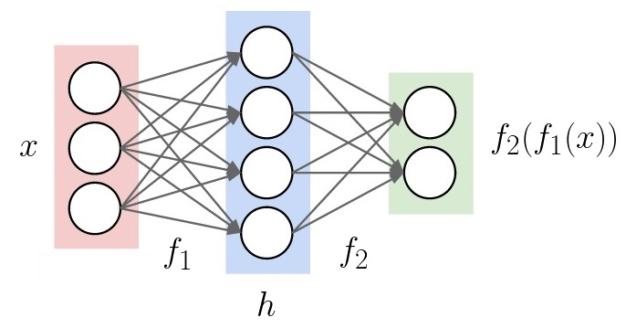
internal covariate shift
f1: to learn better feature from x
f2: to learn better feature from h
However, BP changes the parameters of f1 and f2 in the meantime.
https://www.alexirpan.com/public/perils-batch-norm/batch_norm_appendix.html

Slide 3
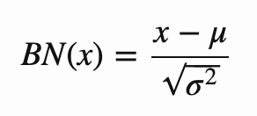
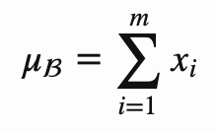
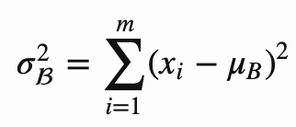
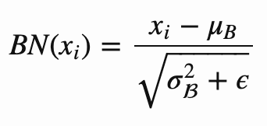

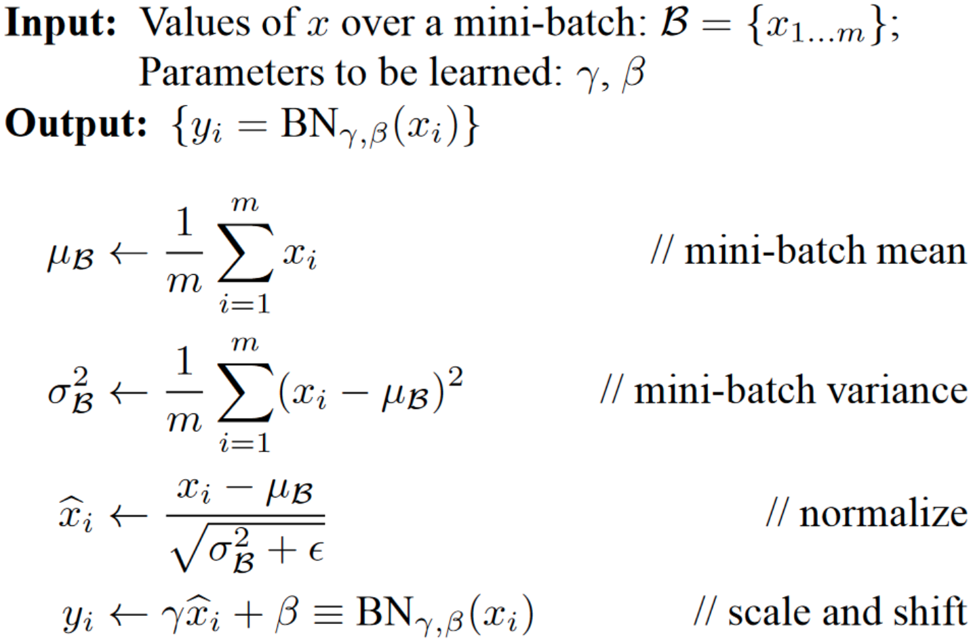

Batch Norm
Add BN layer to normalize every output unit to be mean 0, variance 1?
Batch-wisely:
More than mean 0, variance 1:

Slide 4
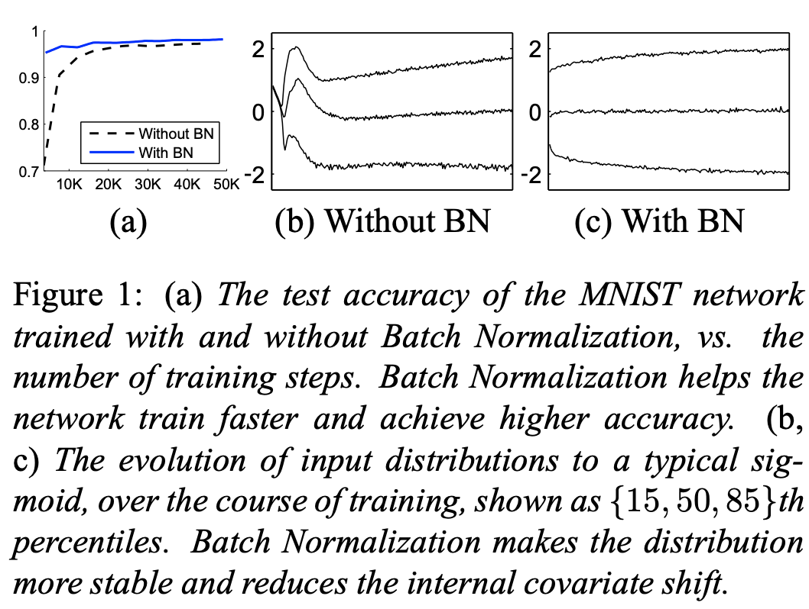
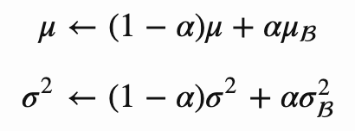
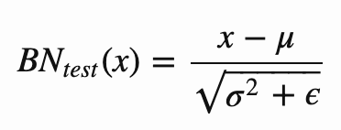
Batch Norm
To learn mean and variance for whole dataset during training
BN in testing:
Cited more than 2w times

Slide 5
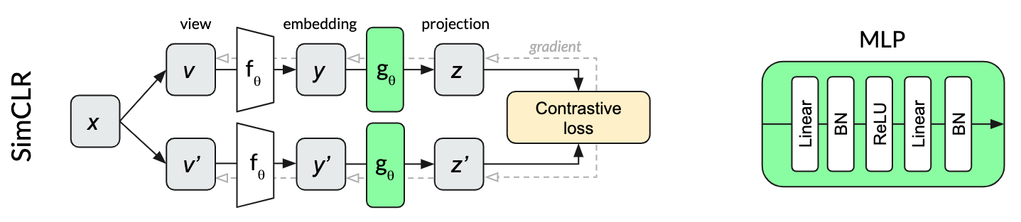
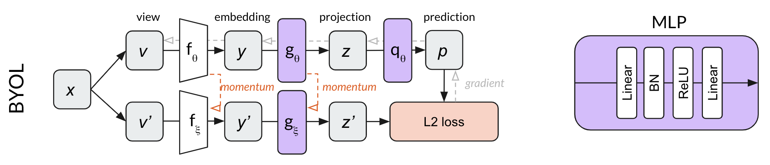
BYOL: Bootstrap Your Own Latent
https://arxiv.org/pdf/2006.07733.pdf
https://untitled-ai.github.io/understanding-self-supervised-contrastive-learning.html

Slide 6
BN in BYOL
If BN is removed from MLP, BYOL works no better than random result, unlike other contrastive learning methods
where negative samples are needed.
Why?
Mode collapse / collapsed representation: predicting directly in representation space can lead to collapsed
representations: for instance, a representation that is constant across views is always fully predictive of itself.
In other methods, negative samples are utilized to prevent mode collapse.
In BYOL, the key is BN. Mode collapse is prevented precisely because all samples in the mini-batch cannot
take on the same value after batch normalization.

Slide 7
BYOL with BN
One way to prevent mode collapse is to identify the common mode between examples.
Batch normalization identifies this common mode between examples of a mini-batch and removes it by using the other representations in the mini-batch as implicit negative examples.
The explicit contrastive approach used by SimCLR and MoCo learns by asking:
“what distinguishes these two specific images from each other?”
With batch normalization, BYOL learns by asking,
“how is this image different from the average image?”
Note:
With batch normalization, the network outputs are no longer learning a pure function of the corresponding inputs.

Slide 8
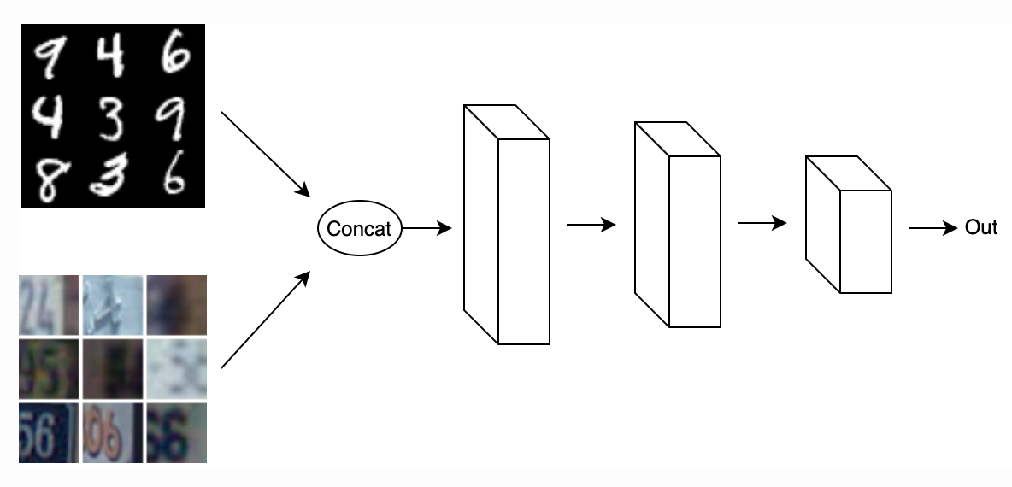
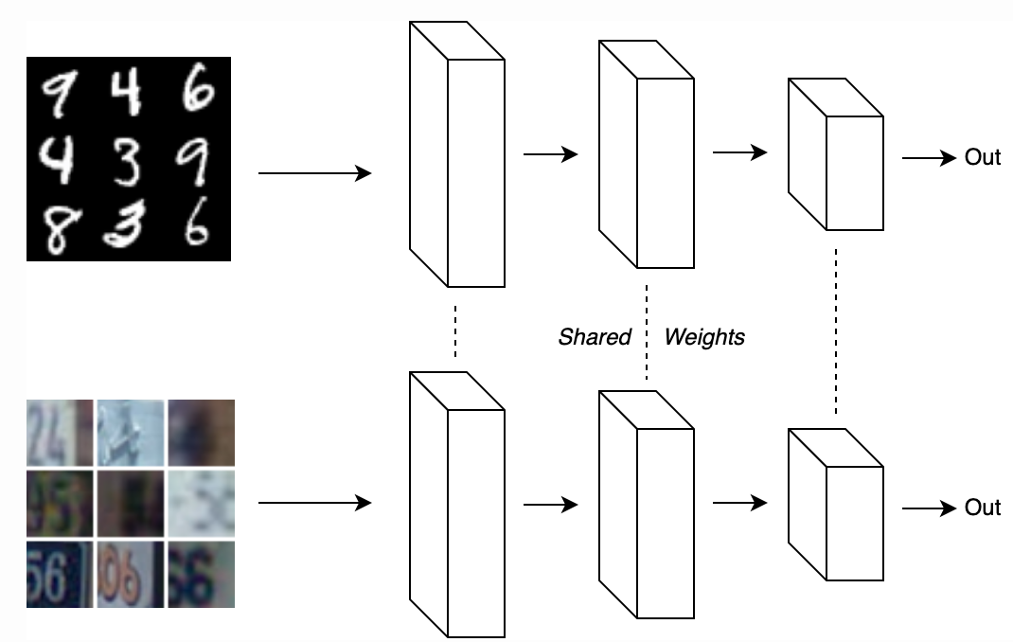
Further Case for BN
Let’s pretend we are classifying two digit datasets, MNIST and SVHN, in two implementations, both with BN.
https://www.alexirpan.com/2017/04/26/perils-batch-norm.html

Slide 9
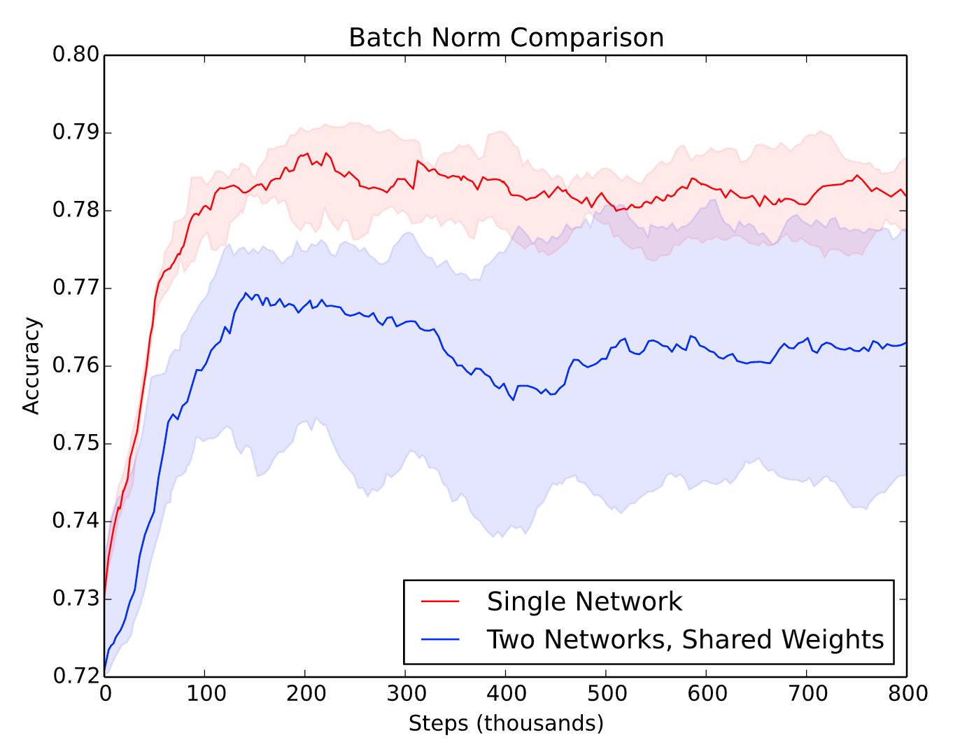
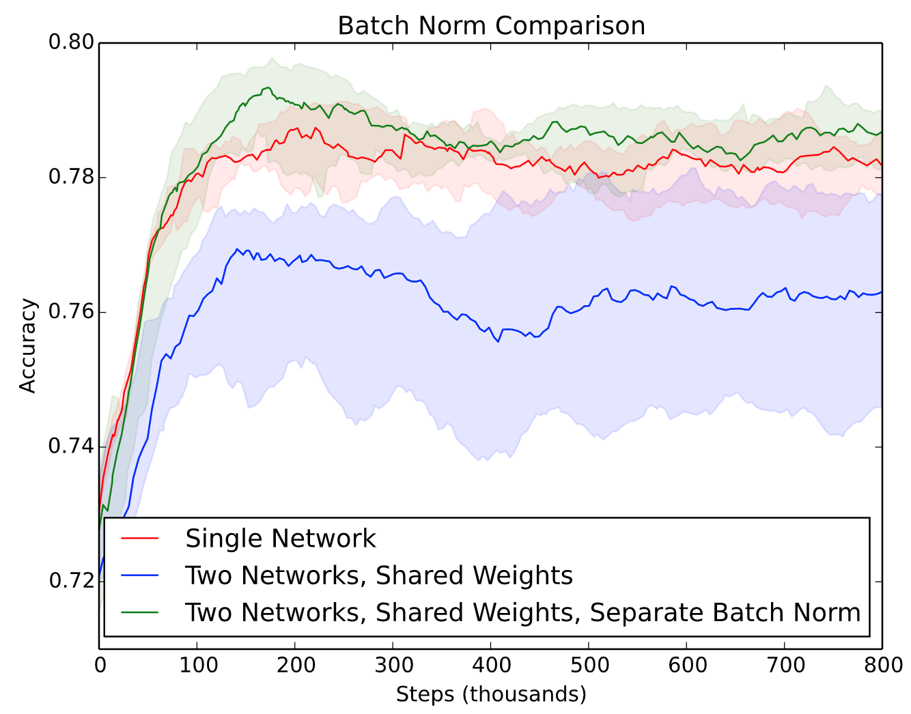
Further Case for of BN

Slide 10
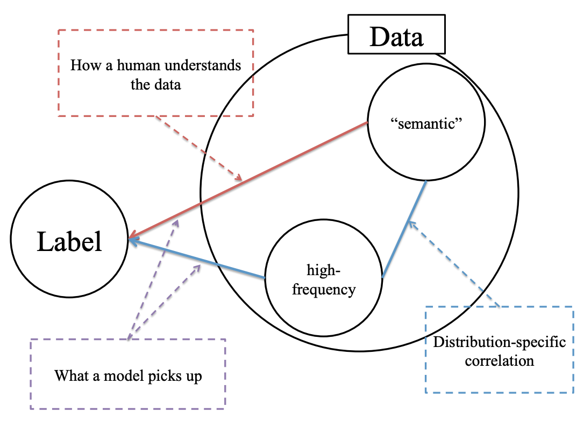
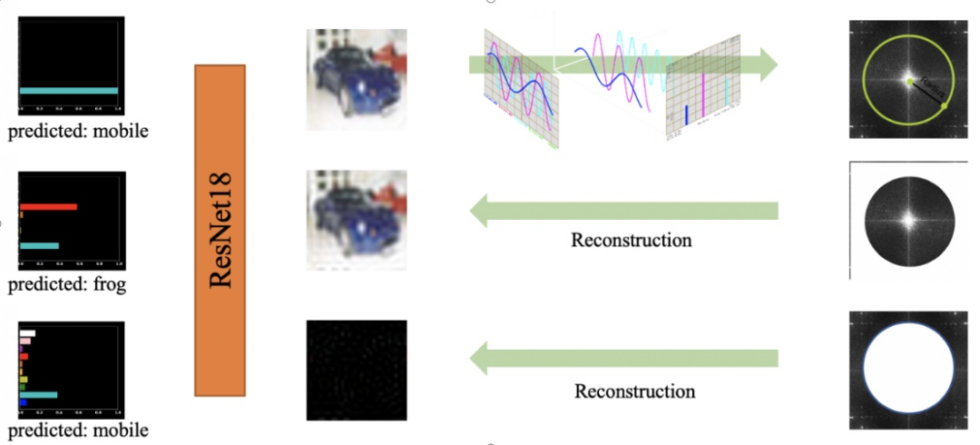
High-frequency Component
~600 images with false result in Cifar10
High-frequency Component Helps Explain the Generalization of Convolutional Neural Networks
https://arxiv.org/pdf/1905.13545.pdf

Slide 11
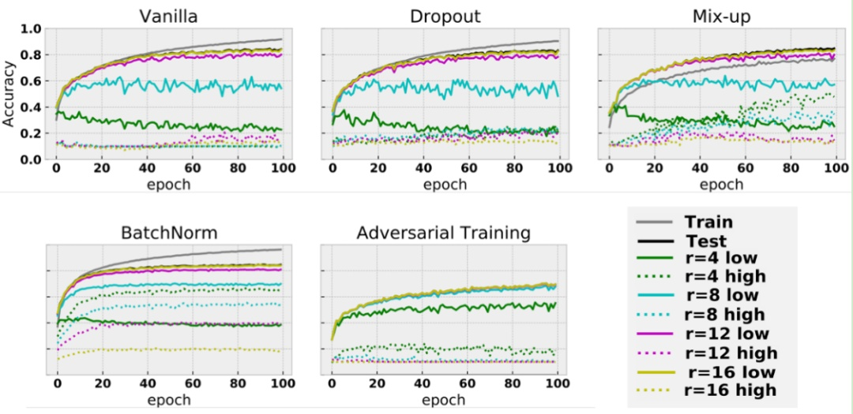
High-frequency Component
BN tends to capture high-frequency component.

Slide 12
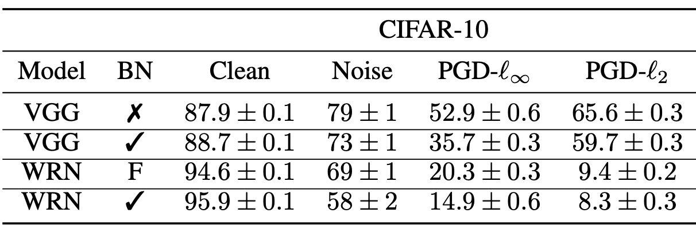
Batch Normalization is a Cause of Adversarial Vulnerability
Batch norm might be the case of being not robust to noise.
When adding noise, the network without BN gave better results.
BN might not be the best idea when you want to optimize for robustness.
https://openreview.net/forum?id=H1x-3xSKDr
https://medium.com/@SeoJaeDuk/archived-post-batch-normalization-is-a-cause-of-adversarial-vulnerability-48a9607f31c0

Slide 13
Conclusion
It is interesting to exploit the implicit contrastive effect of BN.
BN tends to capture high-frequent information.
Discriminative model with BN tends not to be robust in real applications. Consider more alternatives like layer normalization or weight standardization with group normalization.
There is no free lunch.

